Slide 1
Volunteers before the courts – when and why?
Dr Michael Eburn
Associate Professor
School of Legal Practice
ANU College of Law
CANBERRA

Slide 2
Volunteers are rarely before the courts
There are no cases of emergency service volunteers being personally sued.
Agencies have been sued for the actions of their volunteers – Goodhue v Volunteer Marine Rescue Association Incorporated [2015] QCA 234. Vicarious liability was never in doubt.

Slide 3
Inquiries
Volunteers may give evidence and be asked to explain why they made decisions that they made but being asked does not mean you don’t have an answer.
Inquiries can’t determine legal rights or wrongs.

Slide 4
Criminal law
Is different. Criminal liability is personal, it can’t be passed to the agency.
Not all criminal offences require proof of intent to cause harm.

Slide 5
R v Wells [2016] NSWDC 169
Mr Wells was originally charged with dangerous driving causing death.
He was acquitted by the jury.
The Crown proceeded with back up charges of negligent driving causing death and making a u-turn without giving way.

Slide 6
What happened
The brigade responded to a hazmat incident (spilled orange juice).
The accused and one other were called to an MVA. They attended the MVA and were returning to collect the crew at the initial incident site.

Slide 7
The u-turn (at [8]):
“He thus drove along the F3 southbound until he reached U-turn bay 10. He decided that he would perform a U-turn through that gap in the median divide. There was a sign at the U-Turn bay which said “no U-turn” but a supplementary sign positioned underneath said “Police, RTA, NRMA and emergency vehicles excepted”.”

Slide 8
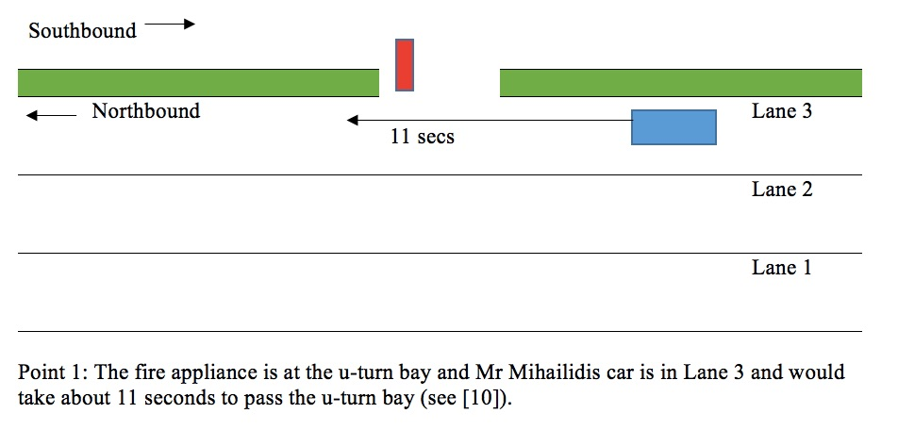
The accident:

Slide 9
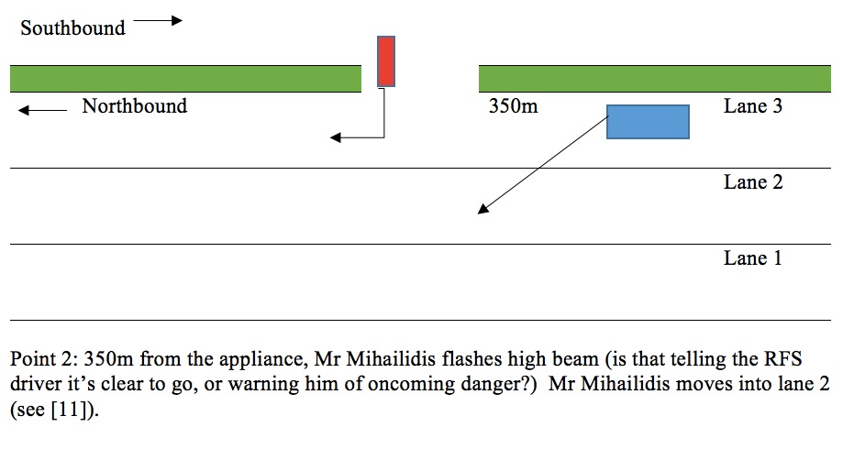
The accident:

Slide 10
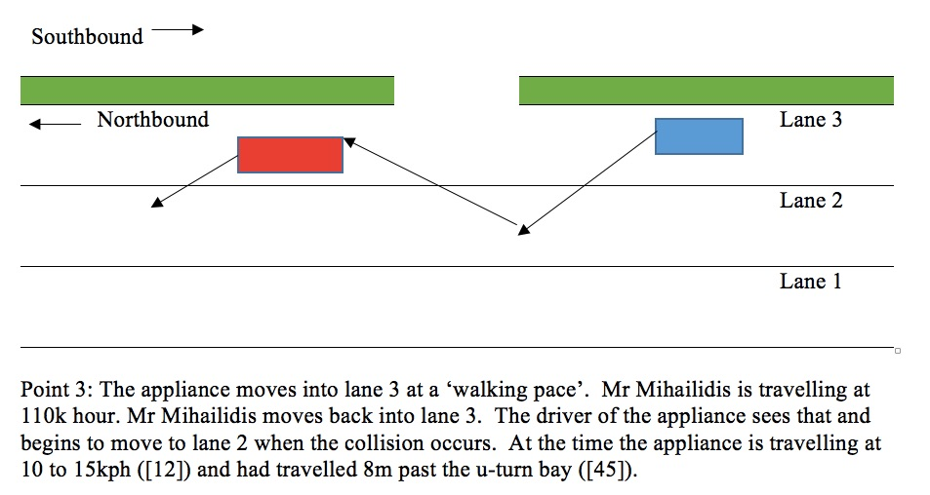
The accident:

Slide 11
“The accused was negligent
in that he failed to take what is the obvious decision when the driver of a heavy vehicle intends to enter the carriageway of a high speed expressway while a vehicle is approaching – wait the 11 seconds or so necessary to allow that vehicle to go past before entering the carriageway…
A reasonable and prudent driver would not have entered lane 3 of the northbound carriageway of the F3, where the speed limit is 110 kph, at night, in a slow moving vehicle, while he or she could see a car approaching in lane 2. By doing what he did he created a risk which was real, obvious and serious. The accused did not exercise that degree of care which the ordinary prudent driver would exercise in the circumstances I have outlined above.
[The accused] didn’t want to lose momentum and have to change down to first gear. [The accused] didn’t want to stop. It was negligent of the accused to fail to do so.” (R v Wells [2016] NSWDC 169 [46]-[48]).

Slide 12
What about
Rural Fires Act 1997 (NSW) s 128
  Driving is not a ‘matter or thing … done in good faith for the purpose of executing any provision … of this or any other Act’
  (Board of Fire Commissioners v Ardouin (1961) 109 CLR 105)
  These provisions relate to civil not criminal law
  (Workcover v NSW Fire Brigades [2006] NSWIRComm 356).

Slide 13
What about
Road Rules 2014 (NSW) r 306
  Rule 306 provides an exemption from ‘A provision of these Rules…’ ‘Negligent driving causing death’ is an offence under the Road Transport Act 2013 (NSW) not the Road Rules.
  Rule 306 only applies if it is reasonable in the circumstances and if the driver was taking ‘reasonable care’.

Slide 14
What about
Road Rules 2014 (NSW) r 306
  Rule 306 applies to ‘to the driver of an emergency vehicle’.
  A vehicle is an emergency vehicle if it is being driving by a member of the RFS ‘providing transport in the course of an emergency’.

Slide 15
What’s an emergency?
It’s undefined in the Road Rules. Responding to both the hazmat and the MVA would have been responding to an emergency, but returning to collect the crew was not.

Slide 16
Button J in the Court of Criminal Appeal ([2017] NSWCCA 242, [132] ):
“… I do not accept that “an emergency” can be an event that does not have at least some aspect of urgency to it. I say that not only as a matter of ordinary English usage. I say that also because … the interpretation for which the appellant contends would lead to absurdities; for example, a tanker being driven to an event that was patently not urgent – such as a routine meeting of volunteer firefighters – could nevertheless be judged as travelling to an emergency, with consequent modification to the operation of the Road Rules… [H]is return to the weighbridge was not, in truth, an emergency as defined by statute.”

Slide 17
The response by the RFS
Operational Brief, Use of U-turn Facilities and Cross-Overs, September 2016
“During proceedings, a number of technical points of law have been raised which has lead to some uncertainly about emergency vehicles using U-Turn and cross over facilities.”

Slide 18
No it didn’t
The definition of what is or is not an emergency vehicle was not new. The Road Rules have always indicated that there had to be an emergency for a vehicle to be an emergency vehicle.
Convenience is not the same as an emergency.
(Murray v McMurchy [1949] 2 DLR 442)

Slide 19
Use the u-turn bay if
It’s an emergency that is time is of the essence, not that it’s convenient.
Take care and make sure other cars have given way. No matter what you’re responding to it doesn’t warrant another accident.
“You can do whatever you like provided you don’t crash”.

Slide 20
Volunteer Fire Fighter’s Association
In response to a different prosecution said:
“The VFFA is deeply concerned that this case sets a precedent; Volunteer Firefighters can be subject to prosecution if salaried staff, without question or any internal investigation, call the NSW Police to report alleged actions of a Volunteer Firefighter based on hearsay.”
(‘NSW RFS Volunteers at Risk of Prosecution without Support or Assistance’ December 18, 2017).

Slide 21
It’s not true
People are subject to prosecution if police form a view that there is evidence of criminality. A report to police is not sufficient.
Where the accused ‘was convicted of dangerous driving in a Local Court case that was heard over three days’ there was persuasive and admissible evidence.

Slide 22
When are volunteers before the courts?
Never on questions of civil liability.
They may be witnesses in inquiries – and that may be tough, but it does not determine legal rights or wrongs.
Criminal prosecutions are rare but not unheard of and mostly relate to driving.
R v Wells is the most significant case involving a volunteer in recent times.

