Slide 1
Australia’s emergency managers – leading, or being led, through change?
Dr Michael Eburn
ANU College of Law
CANBERRA

Slide 2
After major events
The sector is led through change- consider
  2003 Canberra fires Inquest;
  2009 Victorian Bushfires Royal Commission.
Those affected are witnesses but other make sense of the evidence and recommend change.
The recommendations aren’t binding but…

Slide 3
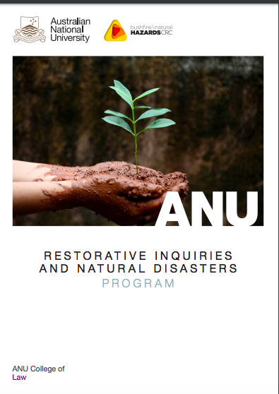

Slide 4
A restorative inquiry
Takes a relational approach- it’s not who did what but how are events connected.
Restorative justice or restorative practices?

Slide 5
“Restorative justice
…is a process whereby all the parties with a stake in a particular offence come together to resolve collectively how to deal with the aftermath of the offence and its implications for the future.” (Eburn and Dovers, p. 67).

Slide 6
“Restorative [inquiry]
…is a process whereby all the parties with a stake … come together to resolve collectively how to deal with the aftermath of the [event] and its implications for the future.”
‘The key element is to put the problem in the centre of the circle’ (John Braithwaite).

Slide 7
Recently an agency announced:
A “…member fell through both the roof and the ceiling, suffering minor injuries… Initial inquiries have identified that at the time of the incident, this member and their team, were not using a Height Safety System…
This incident has been reported to [the Work Health and Safety Regulator] … and will also be investigated by the … Work, Health and Safety team. The result of either … investigations may result in disciplinary action against the members involved”.

Slide 8
Why would anyone contribute to the ‘investigation’?
The problem and the outcome have already been determined.
  They were not using a Height Safety System;
  Disciplinary action will follow.

Slide 9
Ivan Pupulidy, US Forest Service
The OLD Forest Service Serious Accident Investigation Guide (SAIG) manual said:

Slide 10
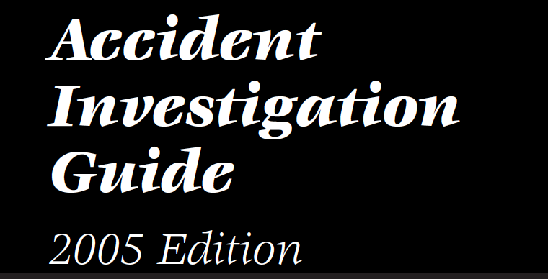
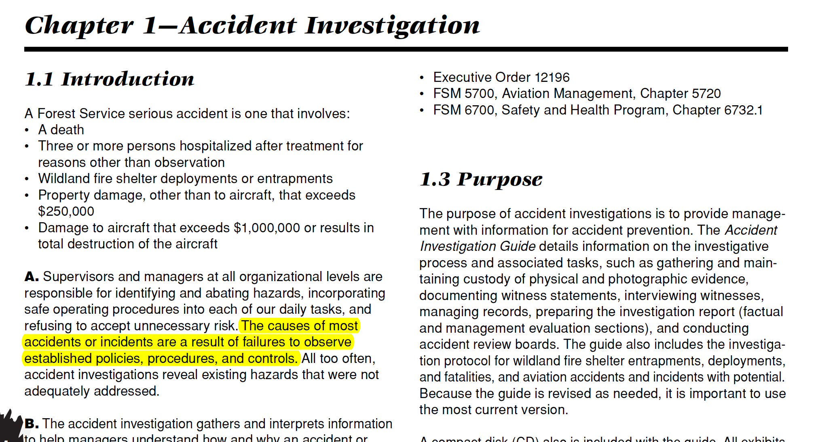
The causes of most
accidents or incidents are a result of failures to observe
established policies, procedures, and controls.
Pupulidy

Slide 11
Ivan Pupulidy, US Forest Service
That removes context and without context, there is no ability to learn from an event.
The SAIG was replaced by the Learning Review in 2014.

Slide 12
Euan Ferguson
“… focus on human factors – what was she thinking when she did this? What was he thinking when he parked the tractor there? What was the team thinking whey the approved the plan without considering these issues? What was the environment they were experiencing? What was their level of skill, competence and experience? How would the reasonable person view the decision?”

Slide 13
In short
Why did this decision make sense to this team?
Because it did make sense or they wouldn’t have done it.

Slide 14
Professor Llewelyn, Canada
Discussed restorative inquiries in Nova Scotia. She identified key differences:

Slide 15
Traditional Public Inquiry | Restorative Approach
Government or legal authority determines scope, terms of reference. | Affected parties (government, former residents, community partners) work together to design the process.
Sole commissioner (often a retired judge) or small panel selected to lead inquiry. | Process guided and overseen by a council of all parties affected – everyone has a stake.
Meetings/hearings are judicial in nature – often held in a courtroom. | Meetings held in a flexible variety of settings, from small groups to wider gatherings, depending on need.
Process focuses on what happened, what went wrong – “finding blame”. | Process examines bigger context: what happened, why it happened, why it matters for the future.
Proceedings can have an adversarial feel, with “witnesses” enlisting legal counsel for support. | Subpoenas will be largely unnecessary in a collaborative approach where all parties have a say in the process. They will be used only as a last resort, with participants prepared and supported beforehand.
Commissioner/small panel develop report and recommendations at the end of the Inquiry. | Affected parties represented on Reflection and Action Team that helps determine next steps. Information will be developed and shared and action can be proposed/enacted throughout the process.
Commission delivers report and recommendations to government, with no authority to make change or ensure follow‐through. | All parties, including decision‐makers and community leaders, have a stake and role in developing and following through on recommendations. Final report will share actions already taken within the process as well as action steps for the future.
Outcomes typically involve new or updated policies/procedures for public agencies | Outcomes should include improved relationships between agencies and communities, better ways of working together. End result will be not only actions but a capacity for and commitment to sustainable change.

Slide 16
Judicial inquiries
Witnesses are required to answer the questions that are put to them by counsel.
It is counsel that makes submissions to the Commissioners or coroner as to what inferences and findings are open on the evidence.
Where there is ambiguity it is up to the tribunal to determine where responsibility lies.

Slide 17
As Professor Llewelyn says:
“They do all the learning. All the information comes to them. All the sorting and hard choices all the figuring it out. They are the knowledge holders, they make the meaning, they make sense out of everybody’s story and testimony and decide what should happen. They hope that once they know and understand you will see the wisdom in what they say. It produces a ‘you should’ result.”

Slide 18
Public inquiries
“… come out of this real desire for change… But they are a stunning process of dampening that desire by the tedious process and length so by the end of it you’re glad it’s over and you take what you can get which is a version of the story of what happened…”

Slide 19
There’s more than one story
The CFA’s Roger Strickland and Tammy Garrett:
“Create an environment where all can tell their story. Everyone’s story will be different but that is normal. Memories and perspective are complex. The stories are different but each builds to the whole picture of the fire/event. Everyone gets to speak and everyone has his or her own, valid story. No blame as errors are learning opportunities.”

Slide 20
Professor Llewelyn
“Move away from the idea that you need to find one story, the official version of the facts... what matters most is understanding a more complex version of how those facts were perceived and understood [by the people who were there].”

Slide 21
Move away from blame
“… if it’s been a disaster [Emergency Service personnel have]… been in the middle of those pictures … [you] should probably treat them as you would treat anyone who you immediately identify as blameless or victims. That’s part of moving out of blame see and encounter human beings with meaning not simplistically on one side or the other.”

Slide 22
What can agencies do to lead?
Use restorative practices when you have the smaller event and then you can show that it is possible at a micro level.
Give capacity to demonstrate ‘this is how it can work and what can be achieved’. Build a basis of knowledge and experience/

Slide 23
Look to others that are leading -
The US Forest Service;
The CFA;
The Inspectors General of Emergency Management (Qld and Vic);
Non-judicial inquiries eg those led by Ferguson and Keelty.

Slide 24
In summary
Focus on relationships and interconnections across all affected stakeholders.
‘Blame is a wasted emotion’. Everyone has responsibility for helping to identify why the event is important and what the event means for the future. The people who were there and best placed to decide what is important.

Slide 25
In summary
Communities and people need to be at the centre of the process. Those affected need to be involved in designing the process and taking responsibilities for implementing the learning.
Telling stories – the re-story – is important. Do not aim to produce ‘the’ story of what happened. There are multiple stories and perspectives that need to be told and heard.

Slide 26
In summary
Focus on human systems.
Be intentional. If you want a restorative inquiry it has to be designed that way from the start.
In order to move forward agencies have to start internally.

Slide 27
Thank you
Euan Ferguson (Former CFS and CFA chief officer)
Ivan Pupulidy (US Forest Service)
John Braithwaite (ANU RegNet)
Anne Leadbeater (Community leader)
Roger Strickland and Tammy Garrett (CFA)
Iain McKenzie (IGEM Qld) and
Professor Jennifer Llewelyn (Schulich School of Law, Dalhousie University, Nova Scotia Canada).

