Slide 1
Questions about liability:
Presentation to the Canobolas Zone,
NSW Rural Fire Service
16 April 2015
Dr Michael Eburn
Associate Professor, ANU College of Law and
Barrister (ACT)

Slide 2
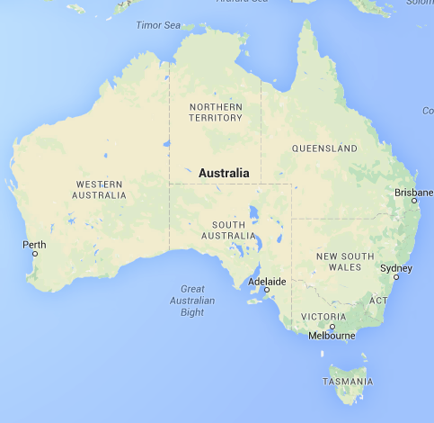

Slide 3
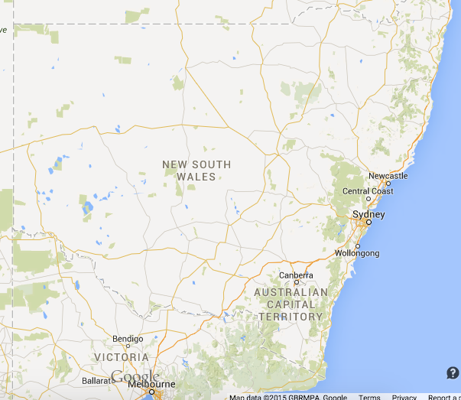

Slide 4
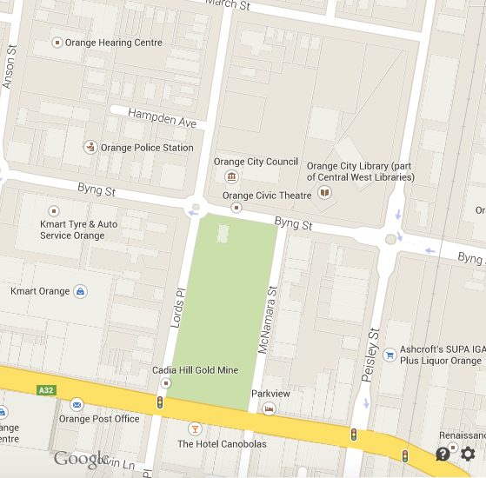

Slide 5
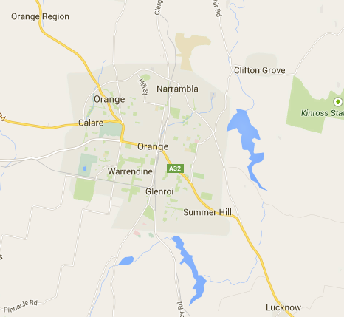

Slide 6
Liability
Means, in my world, an obligation imposed by law – one is liable if one has to pay money, or go to goal.
The law can impose other remedies – orders to do, or not do, something.
Liability is not being asked hard questions.

Slide 7
Liability
Civil law
Criminal law
Coronial law

Slide 10
Liability
Civil law
Criminal law
Coronial law
Negligence
Traffic law
WHS
Also Royal Commissions, Parliamentary Inquiries and other post event procedures

Slide 11
Compensation
Deterrence
Fact Finding
Employment, volunteer, RFS and insurance law
Civil law
Criminal law
Coronial law
Negligence
Traffic law
WHS
Also Royal Commissions, Parliamentary Inquiries and other post event procedures

Slide 12
Thank you for your attention
Dr Michael Eburn
P: (02) 6125 6424
E: michael.eburn@anu.edu.au
Blog: https://emergencylaw.wordpress.com/

