Slide 1
Disasters and Law
Dr Michael Eburn
Associate Professor Visiting Scholar
ANU College of Law Disaster and Development Network
The Australian National University Northumbria University
CANBERRA NEWCASTLE-UPON-TYNE

Slide 2
What is ‘law’?
How is it different from other rules?
  Rules of custom?
  Rules of the game?
  Rules of institutions – eg Northumbria Uni?

Slide 3
Laws about laws
Rules to let us recognise law:
  Who can make law?
  What do laws look like – the form of law?
Rules about applying law:
  Legal procedure;
  Rules of interpretation;
  What’s acceptable evidence and proof.

Slide 4

Consider
Bylaws for the regulation of Cycling and Vehicles on the Town Moor
2.(1) No person shall, except in case of emergency or with the consent of the Council or the stewards committee, ride or drive a mechanically propelled vehicle on the Town Moor, except on a road or on any part of the Town Moor where there is a right of way for that class of vehicle.
(https://www.newcastle.gov.uk/your-council-and-democracy/legal-advice/bylaws/cycling-and-vehicles-on-the-town-moor)
UK law - http://www.bailii.org/

Slide 5
What do laws do?
Prohibit conduct (crime);
Allow conduct (permits, licences, authorities, property law);
Formalise relationships (contracts, marriage, civil unions);
Adjust rights and interests (tort law, family law);
Regulate government (administrative law, constitutional law).

Slide 6
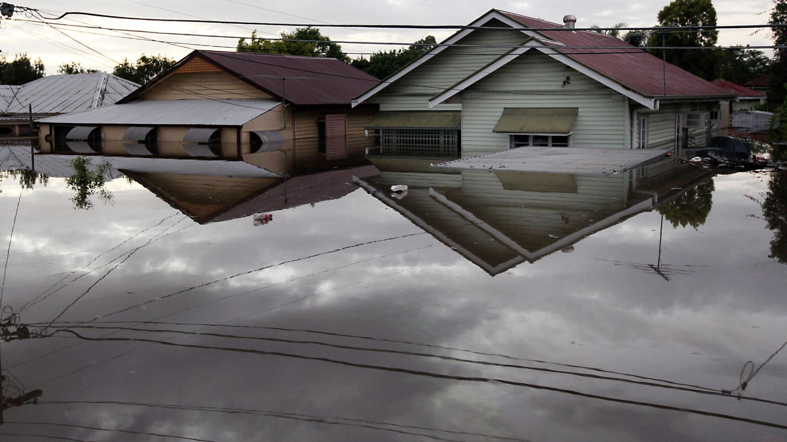
How does law affect vulnerability?

Slide 7
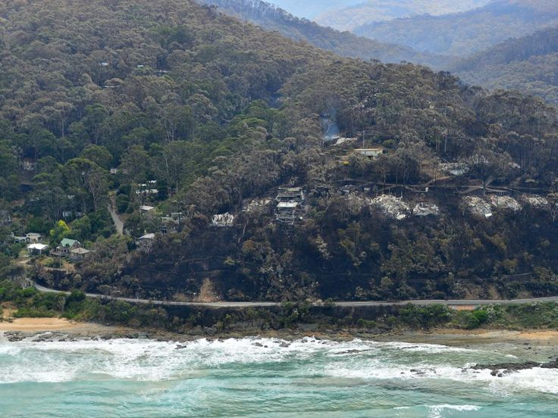

Slide 8
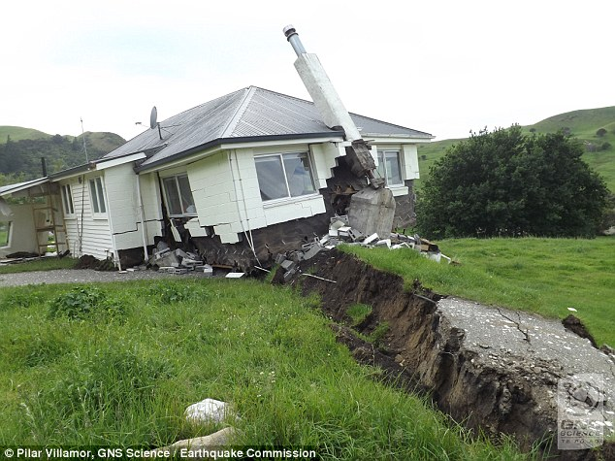

Slide 9
What should lawmakers do?
“Our society and therefore our laws, reflect Western democratic values and capitalist philosophies, which inevitably influence the choice and development of government environmental policies and thus the scope and content of environmental law.”
(Bates, G., Environmental Law in Australia (9th ed, 2016, Lexis/Nexis),[1.3]).

Slide 10
What should lawmakers do?
“Our society and therefore our laws, reflect Western democratic values and capitalist philosophies, which inevitably influence the choice and development of government environmental policies and thus the scope and content of environmental law.”
(Bates, G., Environmental Law in Australia (9th ed, 2016, Lexis/Nexis),[1.3]).

Slide 11
“… environmental law in reality is not so much about blanket protection of ‘the environment’ as about enabling decisions to be made that reflect a balance, or, better an integration, between different environments that are the concern of governments.
These environments include the natural environment, the built or urban environment, the cultural environment and the economic, social, health and work environments…” ([1.4]).

Slide 12
“… environmental law in reality is not so much about blanket protection of ‘the environment’ as about enabling decisions to be made that reflect a balance, or, better an integration, between different environments that are the concern of governments.
These environments include the natural environment, the built or urban environment, the cultural environment and the economic, social, health and work environments…” ([1.4]).

Slide 13
Bushfire-ravaged towns should not be rebuilt, says planning expert…
‘I think governments have a responsibility to prevent people from doing extreme harm or potential harm to themselves’.
(Associate Professor Michael Buxton, Planning and Environment, RMIT University, Melbourne, 6 January 2017
http://www.abc.net.au/7.30/content/2017/s4601010.htm).
Do they?

Slide 14
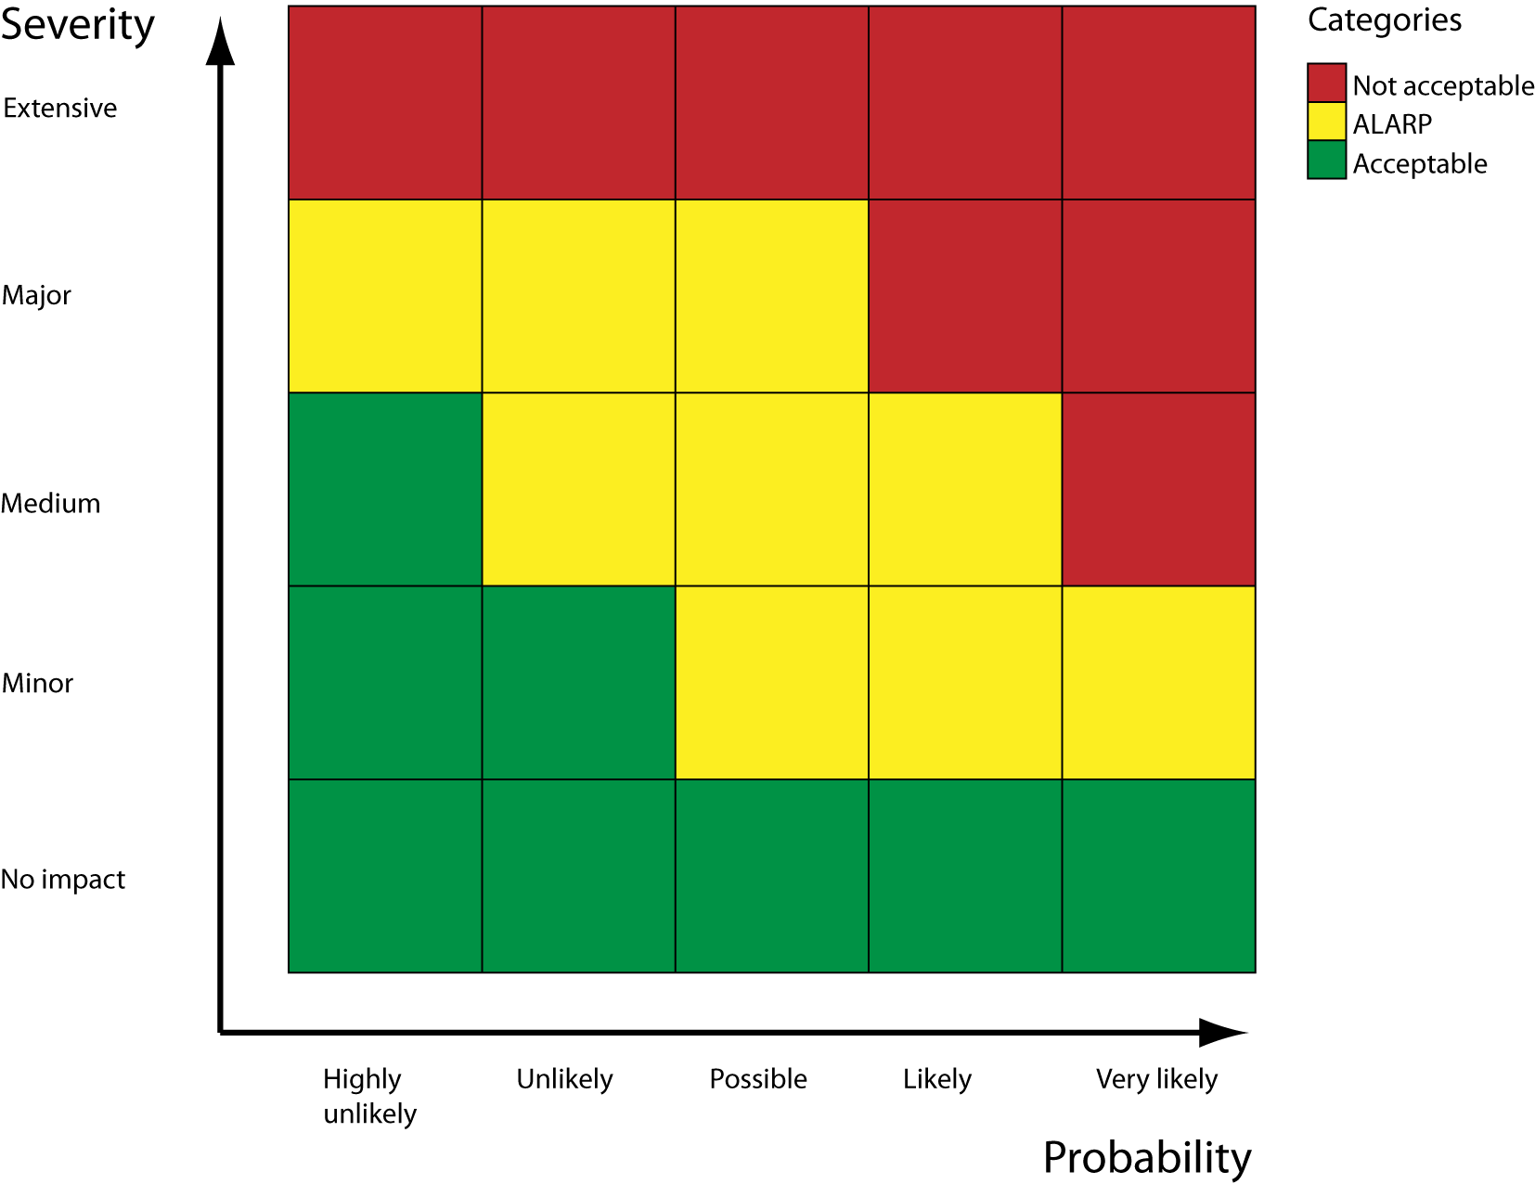
What should lawmakers do?

Slide 15
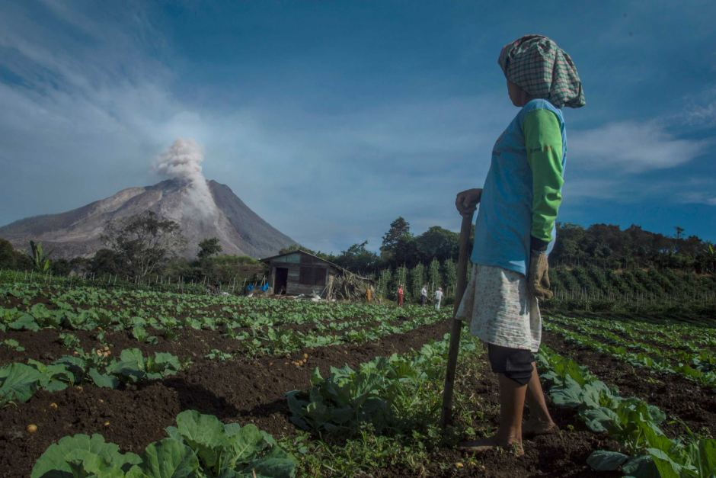

Slide 16
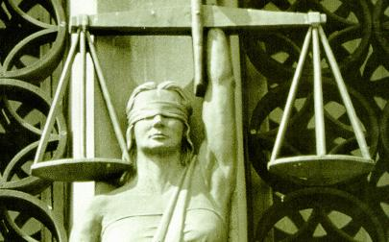

Slide 17
So how does law aid resilience?
Planning laws do exist.
Laws create and empower responders:
  Civil Contingencies Act 2004 (UK);
  Fire Services Act 1947 (UK).
And citizens:
  Human Rights Act 1998 (UK)?
Can be used to hold others to account.

Slide 18


Slide 19
Beyond the UK (and Australia) …
Law reflects the values and philosophies of the dominant culture.
Respect for law is also culturally determined.
How you see risk depends on who you are and where you are.

Slide 20


Slide 21
International law
Law between states.
Sources of international law:
  a. international conventions…
  b. international custom, as evidence of a general practice accepted as law;
  c. the general principles of law recognized by civilized nations;
  d. … judicial decisions and the teachings of the most highly qualified publicists of the various nations…
  (Statute of the International Court of Justice, Art. 38).

Slide 22
International law
Is unlike domestic law:
  It does not (usually) contain explicit requirements;
  Enforcement depends on political will and ‘disapproval’;
  At UN level, there is no ‘legislature’;
  Distinction between ‘hard’ and ‘soft’ law – eg Sendai Framework for Disaster Risk Reduction.

Slide 23
Does international law really help?
International law works best when state interests coincide –areas such as ‘… diplomatic privileges, territorial jurisdiction, extradition, wide fields of maritime law, arbitral procedure, and so forth’.
‘Where there is neither community of interests nor balance of power, there is no international law’.
Hans J. Morgenthau, ‘Positivism, Functionalism, and International Law’ (1940) 34(2)The American Journal of International Law 260-284.

Slide 24
Where does DRR/IDR sit?
‘With natural disasters, the interests of both the victim and assisting states converge on maintaining as much sovereignty as possible – a convergence that does not stimulate the robust development of international law.’
David Fidler, ‘Disaster Relief and Governance after the Indian Ocean Tsunami: What Role for International Law?’ (2005) 6(2) Melbourne Journal of International Law 458-473.

Slide 25
In IDL sovereignty is the driving force
UNGA Resolution 46/182 on
Strengthening of the coordination of humanitarian emergency assistance of the United Nations
  “The sovereignty, territorial integrity and national unity of States must be fully respected in accordance with the Charter of the United Nations.”

Slide 26
Sendai
Doesn’t mention sovereignty but does say ‘Each State has the primary responsibility to prevent and reduce disaster risk…’ [19(a) Guiding Principles]

Slide 27
The International Law Commission
‘… reaffirms the primary role of the affected State in the provision of disaster relief assistance, which is a core element of the draft articles. The reference to sovereignty, and the primary role of the affected State, provides the background against which the entire set of draft articles is to be understood.’
(Draft Articles on the Protection of Persons in the Event of Disasters, Commentary, Preamble [6] (2016)).

Slide 28
So what…
Declarations like Sendai are helpful.
  Point in a common direction and policy goals.
  May be a tool for diplomacy.
  Encourage compliance as states want to be seen to be good citizens.

Slide 29
Concluding comments
Don’t let ‘faith in and commitment to the promise of … law’* be misplaced.
*(Alan Boyle and Christine Chinkin, The Making of International Law (Oxford, 2007, p. 12).
Relying on law can lead to a focus on compliance rather than outcome.
The law is not the problem …
Nor is it the solution …
It’s a tool to help achieve an outcome.

Slide 30
Questions? Comments?
Thank you for your attention.
  Dr Michael Eburn
  Australian National University, College of Law and
  Northumbria University, Disaster and Development Network
  E: michael.eburn@anu.edu.au
  E: michael.eburn@northumbria.ac.uk
  P: +61 2 6125 6424 (Australia)
  P: +44 737 621 6647 (UK)

