Slide 1
Lessons From Emergency Services
Associate Professor Dr Michael Eburn
ANU College of Law
The Australian National University
CANBERRA

Slide 2
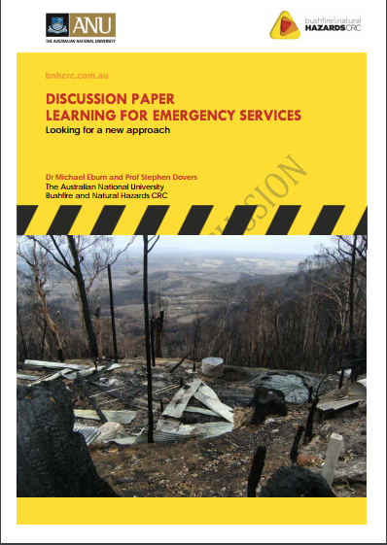
Presenting our paper

Slide 3
The question is
Not ‘What have post event reviews told us about emergency response?’; but
‘What have post event reviews told us about post event reviews?’

Slide 4
Motivation for calling inquiries
We hope it’s to ‘to determine what we can learn from the examination and what we need to do to prevent or mitigate another like event’.

Slide 5
But it may be
‘… for politically expedient reasons such as to show concern about an issue, give an illusion of action, show responsiveness to a problem, co‐opt critics, reduce opposition, delay decision‐making and reassert control of the policy agenda.’
The desire to assign responsibility or blame?

Slide 6
What do they teach us?
“That it was allowed to happen, despite all the accumulated wisdom of so many previous reports and guidelines must indicate that the lessons of past disasters and the recommendations following them had not been taken sufficiently to heart… there is no point in holding inquiries or publishing guidance unless the recommendations are followed diligently. That must be the first lesson.”

Slide 7
But following recommendation diligently may not help
They may not be practical;
They not be helpful;
They may be too expensive;
They may reveal other vulnerabilities;
No two events are the same;
They may be in conflict … consider ‘A tale of two coroners…’

Slide 8
The death of Alison Hume (Scotland)
… some imagination, flexibility, and adaptability were necessary… a balance to be struck between the interests and safety of the rescuers, and those of the casualty …what presents as a danger to the rescuer, when set against the need to rescue the casualty, can be a matter of fine judgement… a preoccupation with adherence to … policy … The core consideration of a risk assessment is a question of whether or not the risks to be taken are proportionate to the benefits gained. That must be an objective consideration.

Slide 9
The death of Michael Wilson (NSW)
“Early activation of a Duty Operations Manager … would have introduced a level of external command and control.” … “The CHC Operations Manuel should include a comprehensive procedure …” equipment not be used for purposes other than its designed purpose… crews do not vary operating procedures unless authorised in the operations manual…

Slide 10
Dekker recommends
Against a lesson learning process that makes specific recommendations. Any recommendation suffers from hindsight bias.
Try to understand and explain why the decision makers made the decision that they did; ‘people do not come to work to do a bad job’ or to die.

Slide 11
The human factors
The need to be heard; to tell a story.
The need to restore relationships.
Royal Commissions/Coroners are
  Adversarial (even if they don’t want to be);
  Make recommendations based on counterfactuals;
  Don’t allow people to tell their story.

Slide 12
Alternatives
The CASA no blame model.
The health sector’s open disclosure model.
Restorative justice.

Slide 13
Restorative justice
Disasters harm communities and relationships between government and citizens.
Aims to undo the harm.
Restorative justice is a process whereby all the parties with a stake in a particular event come together to resolve collectively how to deal with the aftermath and its implications for the future.

Slide 14
Restorative justice is
Consistent with shared responsibility.
Not unique.
Do we need a standing body – the Fire and Emergency Safety Bureau to facilitate inquiries and share the lessons identified?

Slide 15
What next?
Download the paper http://www.bnhcrc.com.au/publications/biblio/bnh-3054
What do you think? Are the suggestions helpful?
Comments and feedback welcome – send to michael.eburn@anu.edu.au.
Thank you.

