Slide 1
Legal responsibilities and accountability within emergency first aid.
Associate Professor Dr Michael Eburn
ANU College of Law
The Australian National University
CANBERRA

Slide 2
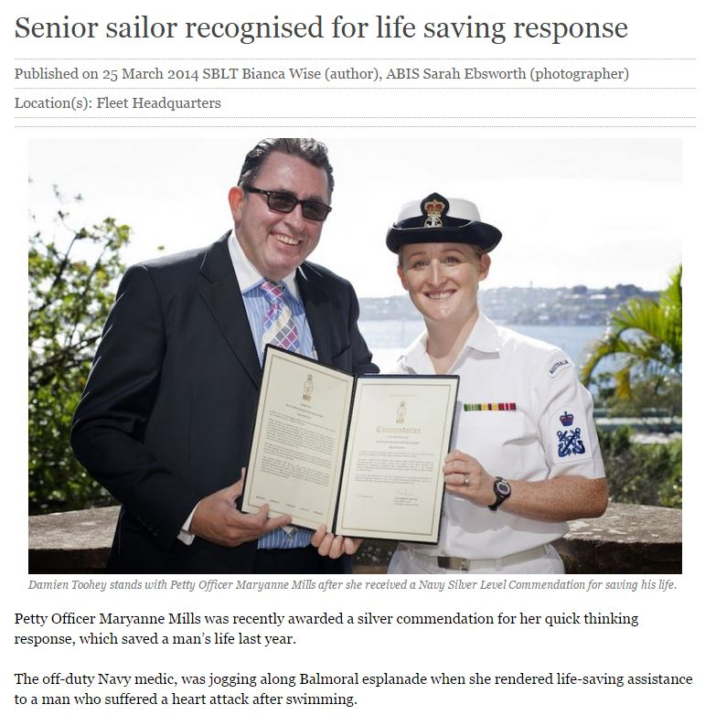

Slide 4
What law?
Negligence:
  Is there a duty of care;
  What does it require.
  What are the defences.
Battery:
  What does it require.
  What are the defences.

Slide 5
Duty of care
There is no ‘duty to rescue’;
But there may be if you hold yourself out as being available to help.
  Doctors;
  Members of first aid and emergency service organisations?

Slide 6
Breach
The duty requires someone to act ‘reasonably’ taking into account their skills and training.
It is not a duty to make things better.
It is not a duty to guarantee a good outcome.
In the first aid context, it’s no more than a duty not to make the pt’s condition worse.

Slide 7
If you do help
“Under current law, the fact that a person (including a health- professional) was acting in an emergency situation is relevant to deciding whether the person acted negligently. It may be reasonable in an emergency situation to take a risk that it would not be reasonable to take if there was no emergency, provided that precautions appropriate to the circumstances are taken to prevent the risk materialising.”
Review of the Law of Negligence (Commonwealth of Australia, 2002).

Slide 8
But
“Also relevant to the issue of negligence is the skill that the good Samaritan professed to have. Suppose a passenger on an aircraft has a heart attack, and in response to a call for assistance by the cabin staff, a 60 year old specialist dermatologist goes to the passenger’s aid. The standard of care expected of the doctor would be set not only taking account of the emergency nature of the situation, but also of the fact that a doctor who has practised as a dermatologist for many years could not be expected to be as well-qualified and able to provide emergency treatment for a heart-attack victim as a cardiac surgeon or even, perhaps, an active general practitioner.”
The community would probably expect a high level of relevant skill from a navy medic!

Slide 9
There’s nearly always a better defendant
A person who causes an accident is liable for the ‘natural and probable consequences’ of the event, including the negligent provision of first aid.
An injured person will always be better off looking for a remedy against the driver, employer or other.

Slide 10
A segue
The person who causes an accident also owes a duty to the rescuer;
So if you’re injured doing first aid you may have a right to look to the tortfeasor for compensation.

Slide 11
Battery
‘The fundamental principle, plain and incontestable, is that every person's body is inviolate. It has long been established that any touching of another person, however slight, may amount to a battery.’
(Collins v Wilcock [1984] 3 All ER 374)
Hostility is not required.
Nor does it matter that it helps.
(Malette v Shulman (1990) 67 DLR (4th) 321).

Slide 12
Defence
Consent:
  Express;
  Implied.
Implied consent does not justify the treatment of the unconscious.
Necessity does.

Slide 13
Necessity
‘… not only (1) must there be a necessity to act when it is not practicable to communicate with the assisted person, but also (2) the action taken must be such as a reasonable person would in all the circumstances take, acting in the best interests of the assisted person.’

Slide 14
But
‘… officious intervention cannot be justified by the principle of necessity. So intervention cannot be justified when another more appropriate person is available and willing to act; nor can it be justified when it is contrary to the known wishes of the assisted person …
(In re F [1990] 2 AC 1 (Lord Goff)).

Slide 15
Refusal of life saving treatment
Must be:
  Informed;
  Competent; and
  Cover the situation that has arisen.
  (In Re T [1992] EWCA Civ 18).
But:
  May be communicated by any means.
  Need not be rational or sensible or for any reason
  (Malette v Shulman (1990) 67 DLR (4th) 321).

Slide 16
Treatment after suicide attempt
Attempted suicide does not prove mental illness or incompetence.
(Stuart v Kirkland-Veenstra [2009] HCA 15).
But, a first aider can’t assess that. If the patient is unconscious or unable to express consent, treat them. If they can and do refuse consent, call an ambulance!
There is a common law and statutory power to prevent a suicide
(see, for example, Crimes Act 1958 (Vic) s 463B).

Slide 17
Parents and guardians
Can refuse consent but must act in the person’s best interests.
In some states Medical Practitioners can administer treatment in the absence of consent. Not applicable in first aid.

Slide 18
If parent’s refuse
And the condition’s not urgent or life threatening, ok.
If it is urgent, ring an ambulance.
No one’s going to sue, and no-one’s going to win!

Slide 19
The mentally ill
Should be involved to the extent that they can be, in their health care decision making.
Retain their rights to dignity and to have their wishes respected
(see, for example, Mental Health Act 2007 (NSW) s 3).

Slide 20
The mentally ill
Necessity applies.
Paramedics and police have authority to treat the mentally ill in the face of their objection but the legislative criteria must be met.
If it’s urgent or they pose a danger to themselves or others ring the ambulance or police.

Slide 21
‘Good Samaritan’ provisions
Civil Liability Act 2002 (NSW) s 57; Civil Liability Act 2002 (WA) s 5AD.
Applies ‘to civil liability of any kind’.
A Good Samaritan is ‘a person who, in good faith and without expectation of payment or other reward, comes to the assistance of a person who is apparently injured or at risk of being injured’.

Slide 22
Protection
‘A good samaritan does not incur any personal civil liability in respect of any act or omission done or made by the good samaritan in an emergency when assisting a person who is apparently injured or at risk of being injured.’

Slide 23
Protection is lost if the good Samaritan:
Caused the injury; or
Is affected by alcohol or drugs; or
Is impersonating a health care or emergency worker, a police officer or claims to have skills they don’t have.
Protection is not lost if the person is not trained. The aim is to encourage action.

Slide 24
First aid at work
A good Samaritan does first aid ‘without expectation of payment or other reward’
That’s not you whilst you’re at work, but it is off the base.
BUT an employee
  Who is injured at work is entitled to workers compensation (no fault);
  Is not liable for negligent performance of their duties (vicarious liability).

Slide 25
Doctors
May be under a duty to assist; but
They’re not expected to be ‘super specialists’.
If you’re interested in the odds: Two have been in trouble for not going; none for giving it a go.

Slide 26
Do I need Professional Indemnity insurance?
No
  You don’t need it;
  You probably can’t find anyone to offer it; and
  If you’re worried about being sued, it will increase the risk.

Slide 27
Questions? Comments?
Thank you for your attention.
Dr Michael Eburn
ANU College of Law
Australian National University
5 Fellows Road
ACTON ACT 2600
P: 02 6125 6424
E: michael.eburn@anu.edu.au
B: https://emergencylaw.wordpress.com/

