Slide 1
Legal responsibilities and accountability within emergency first aid.
Associate Professor Dr Michael Eburn
ANU College of Law
The Australian National University
CANBERRA

Slide 2
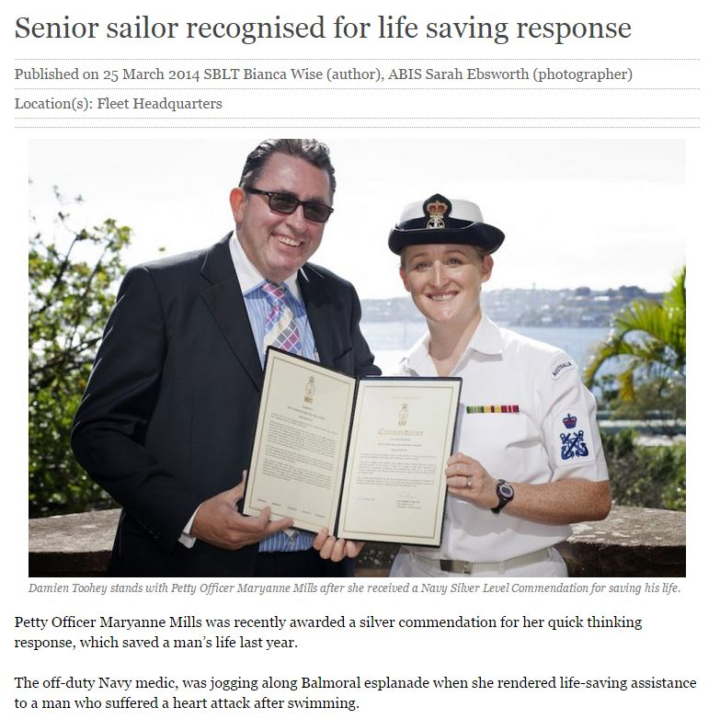

Slide 4
The issue
Using your skills on and off base for the benefit of civilians.

Slide 5
The law
Criminal law
  Prohibited actions.
  Drugs.
Tort law
  Negligence.
  Battery.
Navy (ADF) law

Slide 6
Criminal law
Medicine is largely unregulated.
You can’t call yourself a medical practitioner or nurse (unless you are one).
And there are some practices you can’t do:
  Restricted dental acts;
  Anaesthesia in dentistry;
  Prescription of optical appliances; and
  Spinal manipulation.
  Health Practitioner Regulation National Law (NSW) ss 113-123.

Slide 7
So what does that mean for ‘advanced’ skills?
Such as:
  Using oxygen?
  Using an AED?
  Releasing a tension pneumothorax?
  Administering IV fluids?
  Intubation?
  Tracheotomy?

Slide 8
Drugs are different
It is an offence to possess or supply schedule 4 and schedule 8 drugs without an authority.
Poisons and Therapeutic Goods Act 1966 (NSW).
“A member of the Defence Force is not bound by any law of a State or Territory… (b) that would require the member to have permission (whether in the form of a licence or otherwise) to do anything in the course of his or her duties as a member of the Defence Force.”
Defence Act 1903 (Cth) s 123.

Slide 9
Drugs are different
It is an offence to possess or supply schedule 4 and schedule 8 drugs without an authority.
Poisons and Therapeutic Goods Act 1966 (NSW).
“A member of the Defence Force is not bound by any law of a State or Territory… (b) that would require the member to have permission (whether in the form of a licence or otherwise) to do anything in the course of his or her duties as a member of the Defence Force.”
Defence Act 1903 (Cth) s 123.

Slide 10
Negligence
A duty of care – that is a duty to do something;
Breach – that is a failure to act in a reasonable way in all the circumstances; and
Proof that the ‘breach’ caused some injury, loss or damage.

Slide 11
Duty of care
“The common law generally does not impose a duty upon a person to take affirmative action to protect another from harm…
[and] a public authority … should not be regarded by the common law any differently from a citizen. It should not be considered to have an obligation to act”
Stuart v Kirkland-Veenstra [2009] HCA 15, [127]-[129] (Crennan and Kiefel JJ).

Slide 12
Breach
The duty requires someone to act ‘reasonably’ taking into account their skills and training.
It is not a duty to make things better.
It is not a duty to guarantee a good outcome.
In the first aid context, it’s no more than a duty not to make the patient’s condition worse.

Slide 13
If you do help
“… the fact that a person … was acting in an emergency situation is relevant to deciding whether the person acted negligently.
It may be reasonable in an emergency situation to take a risk that it would not be reasonable to take if there was no emergency…”
Review of the Law of Negligence (Commonwealth of Australia, 2002), [7.22].
Or not do something you would do if it were not an emergency.

Slide 14
But
“The standard of care expected of the doctor would be set not only taking account of the emergency nature of the situation, but also of the fact that a doctor who has practised as a dermatologist for many years could not be expected to be as well-qualified and able to provide emergency treatment for a heart-attack victim as a cardiac surgeon or even, perhaps, an active general practitioner.”
Review of the Law of Negligence (Commonwealth of Australia, 2002), [7.23].

Slide 15
Segue - there’s nearly always a better defendant
A person who causes an accident is liable for the ‘natural and probable consequences’ of the event, including the negligent provision of first aid.
Haynes v Harwood [1935] 1 KB 146; Knightley v Johns [1982] 1 WLR 349.
The person who causes an accident also owes a duty to the rescuer, so if you’re injured doing first aid you may have a right to look to the tortfeasor for compensation.
Chapman v Hearse (1961) 106 CLR 112.

Slide 16
Battery
‘The fundamental principle, plain and incontestable, is that every person's body is inviolate. It has long been established that any touching of another person, however slight, may amount to a battery.’
Collins v Wilcock [1984] 3 All ER 374.
Hostility is not required.
Boughey v R (1986) 161 CLR 10
Nor does it matter that it helps.
Malette v Shulman (1990) 67 DLR (4th) 321.

Slide 17
Defence
Consent:
  Express;
  Implied.
Implied consent does not justify the treatment of the unconscious.
Necessity does.

Slide 18
Necessity
‘… not only (1) must there be a necessity to act when it is not practicable to communicate with the assisted person, but also (2) the action taken must be such as a reasonable person would in all the circumstances take, acting in the best interests of the assisted person.’
In re F [1990] 2 AC 1 (Lord Goff).

Slide 19
But
‘… officious intervention cannot be justified by the principle of necessity. So intervention cannot be justified when another more appropriate person is available and willing to act; nor can it be justified when it is contrary to the known wishes of the assisted person …
In re F [1990] 2 AC 1 (Lord Goff).

Slide 20
Refusal of life saving treatment
Must be:
  Informed;
  Competent; and
  Cover the situation that has arisen.
  In Re T [1992] EWCA Civ 18.
But:
  May be communicated by any means.
  Need not be rational or sensible or for any reason
  Malette v Shulman (1990) 67 DLR (4th) 321.

Slide 21
‘Good Samaritan’ provisions
Civil Liability Act 2002 (NSW) s 57;
Applies ‘to civil liability of any kind’.
A Good Samaritan is ‘a person who, in good faith and without expectation of payment or other reward, comes to the assistance of a person who is apparently injured or at risk of being injured’.
Civil Liability Act 2002 (NSW) s 56.

Slide 22
Protection
‘A good samaritan does not incur any personal civil liability in respect of any act or omission done or made by the good samaritan in an emergency when assisting a person who is apparently injured or at risk of being injured.’
Civil Liability Act 2002 (NSW) s 57(1).

Slide 23
Protection is lost if the good Samaritan:
Caused the injury; or
Is affected by alcohol or drugs; or
Is impersonating a health care or emergency worker, a police officer or claims to have skills they don’t have.
Civil Liability Act 2002 (NSW) s 58.
Protection is not lost if the person is not trained. The aim is to encourage action.

Slide 24
Navy law
A defence member is guilty of an offence if:
(a) a person gives the member a lawful command; and
(b) the person giving the command is a superior officer; and
(c) the member disobeys the command.
Defence Force Discipline Act 1982 (Cth) s 27.

Slide 25
Navy law
A defence member is guilty of an offence if:
(a) a person gives the member a lawful command; and
(b) the person giving the command is a superior officer; and
(c) the member disobeys the command.
Defence Force Discipline Act 1982 (Cth) s 27.

Slide 26
Health Bulletin No 1/2014 – Provision of Emergency Health Support to Civilians
6. Authorised health professionals may render emergency treatment to any civilian to save life and relieve suffering when appropriate civilian health resources are not readily available or until such time as the patient can be safely handed over to civilian health care provider.

Slide 27
Health Bulletin No 1/2014 – Provision of Emergency Health Support to Civilians
… Emergency intervention is not to exceed the level of training and clinical competency of the authorised health professional.
The standard of care applied is to take into account the circumstances surrounding the emergency and the limited medical equipment that may be available.
The principles of consent still apply in an emergency situation.

Slide 28
Health Bulletin No 1/2014 – Provision of Emergency Health Support to Civilians
Authorised health professionals will be acting in the normal course of duty. They are not to accept any form of remuneration either personally or for the services generally.

Slide 29
Questions? Comments?
Thank you for your attention.
Dr Michael Eburn
ANU College of Law
Australian National University
5 Fellows Road
ACTON ACT 2600
P: 02 6125 6424
E: michael.eburn@anu.edu.au
B: https://emergencylaw.wordpress.com/

