Slide 1
Who’s covered? Who’s not?
ACT CTP Citizens Jury
Saturday 28 October
Associate Professor Michael Eburn
ANU College of Law
School of Legal Practice.

Slide 2
Notes:
Assume the vehicle on the right was travelling in the direction of the arrow and has collided with the vehicle on the left.

Slide 3
Notes:
The driver ‘at fault’ is shown with the red outline

Slide 4
Notes:
Who’s covered – all the passengers and the driver of the other vehicle, shown in purple will be covered by the CTP scheme as it currently exists. On the face of it the only person who is not insured and will not receive help to meet medical and other expenses is the ‘driver at fault’.
But that is only true if there really is ‘fault’. In the lead up to the jury there has been discussion of the no fault accident where the driver hits a kangaroo but is that really ‘no fault’? The ‘reasonable driver’ is aware that we live in a place populated by kangaroos, that they are present most particularly at dawn and dusk and that there is a risk of collision. The ‘reasonable driver’, even if not the average or normal or ordinary driver, is looking out for kangaroos and driving at a speed that will allow him or her to stop should a kangaroo appear. It’s not impossible to find that a driver who collides with a kangaroo is at fault.
But our picture is not a kangaroo, it’s another car. What if the ‘driver at fault’ had a sudden and unexpected heart attack, stroke or some other medical event and lost control of the vehicle or worse, died at the wheel? In the absence of any warning they would not be ‘at fault’ and arguably no-one in either car will recover.

Slide 5
Notes:
Let us look at the passengers in the ‘at fault’ car and assume that the driver was at fault and not the victim of a sudden medical emergency.
They will be covered but their entitlement to damages may be reduced. Things that constitute contributory negligence by a passenger may include getting into a vehicle knowing the driver is affected by drugs or alcohol or failing to wear a seat belt – in some states this is set out in the statute – see Motor Accidents Compensation Act 1999 (NSW) s 138.
The passengers will also be denied compensation if they are engaged in a joint illegal enterprise, eg if they are injured as they are trying to get away from a bank robbery.

Slide 6
Notes:
We talk about CTP insurance being an insurance of indemnity that ensures the injured people get paid from the pool of funds that we all contribute to. This protects the assets of the driver at fault who doesn’t have to pay from their own funds. The driver at fault can lose that protection and can be pursued by the CTP insurer or nominal defendant if
The vehicle was unregistered and uninsured (Road Transport (Third-party Insurance) Act 2008 (ACT ) s 174);
The vehicle was being used without authority (s 169);
The driver deliberately caused the injury (s 170); or
The driver was ‘unable to exercise effective control of the motor vehicle’ due to their consumption of drugs or alcohol (s 171).
Where a driver is assessed to be 25% at fault, or more, they can be required to pay a $500 excess (s 167). The driver at fault can also be required to pay $2000 if they fraudulently attempted to avoid paying the correct CTP premium (s 168).
Do the CTP insurers pursue those claims? I don’t know but we don’t see cases in the courts where people challenge the right of the CTP insurer so one might infer that they don’t exercise those rights very often, if at all.

Slide 7
Notes:
What if it was a ‘no fault’ scheme?
Everyone would be covered.

Slide 8
No fault
Removes the need to spend time allocating and apportioning blame.

Slide 9
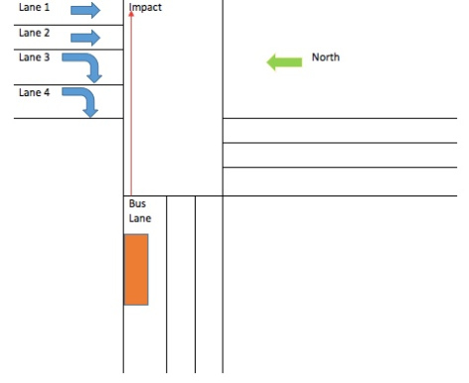
Logar v Ambulance Service of New South Wales Sydney Region
[2017] NSWCA 274
Accident occurred 3 June 2011.
District Court, 14 October 2016.
Court of Appeal, 25 October 2017.
Damages assessed at $867,735.
Macfarlan J would have assessed negligence at 50:50 so driver in lane 1 would have got $433,867.50.
Schmidt and Emmett JJ said no negligence by the driver of the ambulance, plaintiff gets $0.

Slide 10
No fault
Removes the need to spend time allocating and apportioning blame.
Recognises that injury on the road is the price we pay for the right to drive.
Is consistent with:
  Motor Accidents Act 2017 (NSW)
  Transport Accident Act 1986 (Vic)
  National Injury Insurance Scheme
Notes:
Removing fault is unlikely to encourage drivers to drive dangerously. It is unlikely people modify their behaviour because of fear of liability. First people are not liable, CTP picks up the liability so the threat that if you are at fault you will be ruined has already been largely removed.
A bigger inducement to drive safely is self preservation. Driver’s are trying to avoid killing themselves.
The proper forum for retribution and deterrence is the criminal law.
Making it no fault may have premium implications because more people are covered but administrative costs will be reduced as there will not need to be litigation over fault.
The question of fault is different to the question of damages and how damages are calculated and whether or not there are caps on damages. It may be thought that is part of the trade-off, ie reduced damages in exchange for administrative ease and greater cover but that need not be the case. One could retain a right to common law damages (the very personalised and detail assessment of costs) with a no fault scheme. Equally as in NSW (prior to the start of the 2017 Act) you could keep a ‘fault’ scheme and put significant caps and limits on damages (probably the worst of all possible worlds deliberately designed to make it harder for people to recover). Damages and fault need not be considered together and other panels are addressing issues of damages.

